Slide 1
UNDERSTANDING THE EFFECT OF ECONOMIC INDICATORS ON THE STOCK MARKET PERFORMANCE
ADVANCED DATA SCIENCE AND PYTHON FOR FINANCE PROJECT - TEAM 7
Javeria Malik, Varad Gandhi, Kesava Ram Raghavan, Manas Tokale, Tarun Raj

Slide 2
Aim of the Project
The aim of the Project is to understand and analyze the effect of macroeconomic factors on the US stock market.
The US Market has been quite sensitive to financial indicators of the economy and is heavily reliant on the combined performance of diversified sectors.
Our aim in this project is to develop a model for analyzing the effect of these factors and come to a conclusion as to which market is better for investing based on different risk appetites.
For convenience, we are going to work on the following data -
Stock Markets
S&P 500
NASDAQ COMPOSITE
DOW JONES INDUSTRIAL AVERAGE
RUSSELL 3000
Economic Indicators
Consumer Price Index, Personal Consumption Expenditures, Economy money supply, Unemployment rate, Inflation, GDP

Slide 3
CYMBAL
PRODUCT OVERVIEW
ANALYSIS WORKFLOW AND CODE

Slide 4
Data Analysis Workflow
DATA COLLECTION
DATA PREPROCESSING
EXPLORATORY DATA ANALYSIS
MODEL DEVELOPMENT
RESULTS AND VISUALIZATION
Major sources -
Yahoo finance
Federal Reserve Economic Development
Major operations -
Cleaning Data
Merging data
Major operations -
Correlation Matrices
Data viz
Major operations -
Multiple Linear Regression model
Major analysis -
Impact analysis
Significant effect analysis

Slide 5
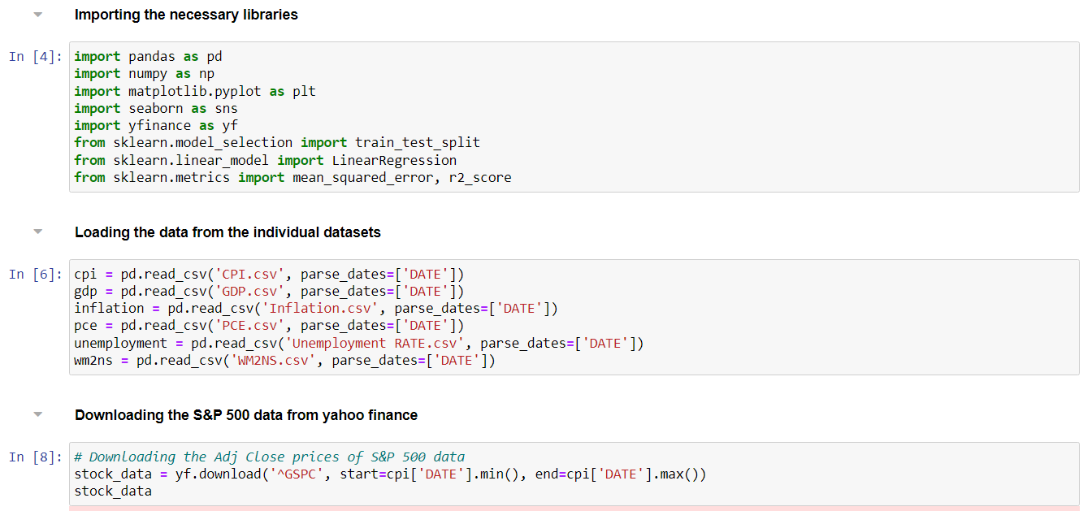
Data Collection
The data is collected from two sources -
STOCK DATA - Yahoo finance
ECONOMIC DATA - FRED website
The extracted data is then read and stored into variables.
For the stock market data, the data right from its date of availability to the current available date is extracted from Yahoo finance.

Slide 6
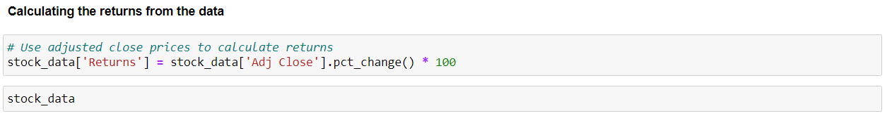
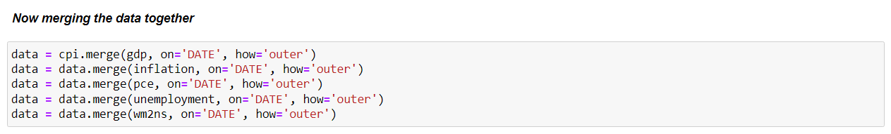
Preprocessing the Data

Slide 7
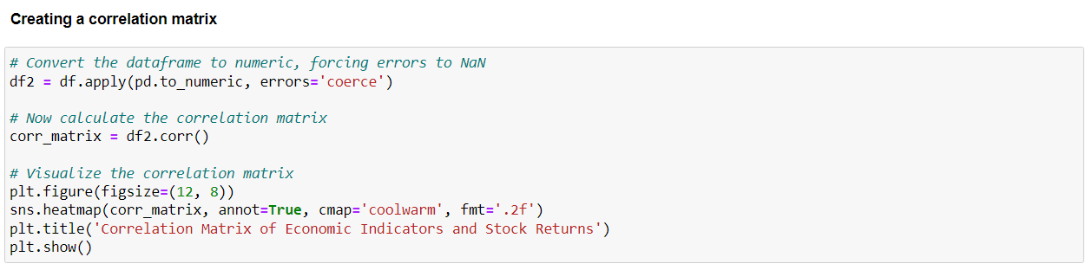
Exploratory Data Analysis
In order to visualize the data, the correlation matrix is used and above is the code for the same. The seaborn functionality is utilized to visualize it and understand the effect of the economic indicators on these markets and their performance.

Slide 8
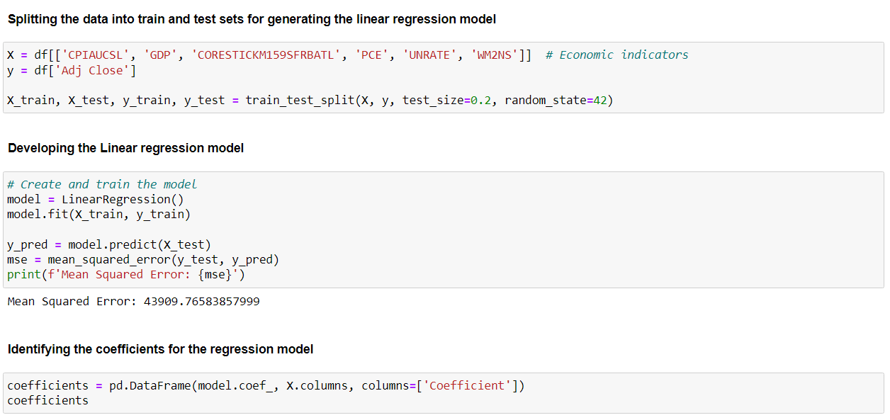
Model Development

Slide 9
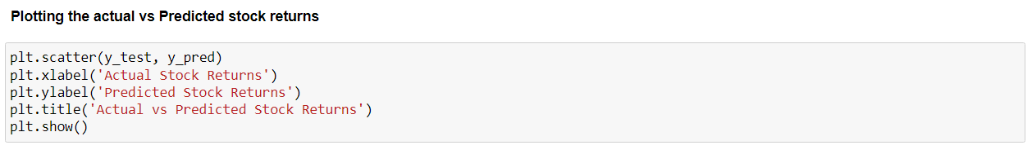
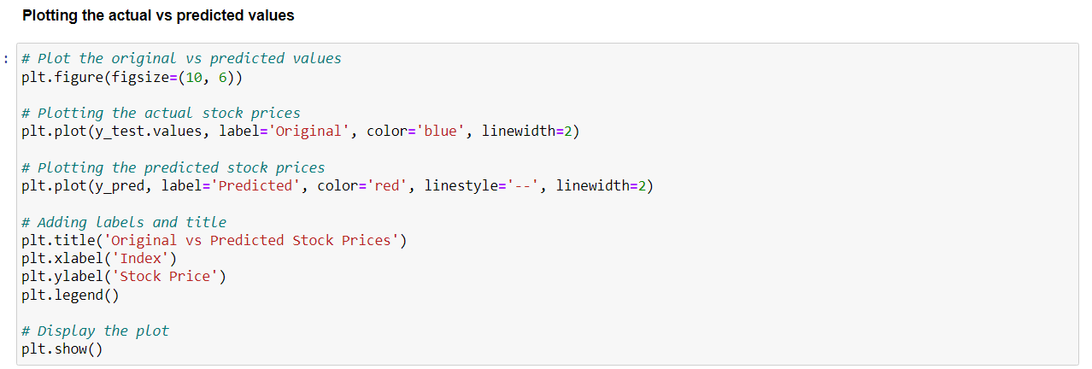
Results and Visualization

Slide 10
CYMBAL
PRODUCT OVERVIEW
OUTPUTS AND VISUALIZATION

Slide 11
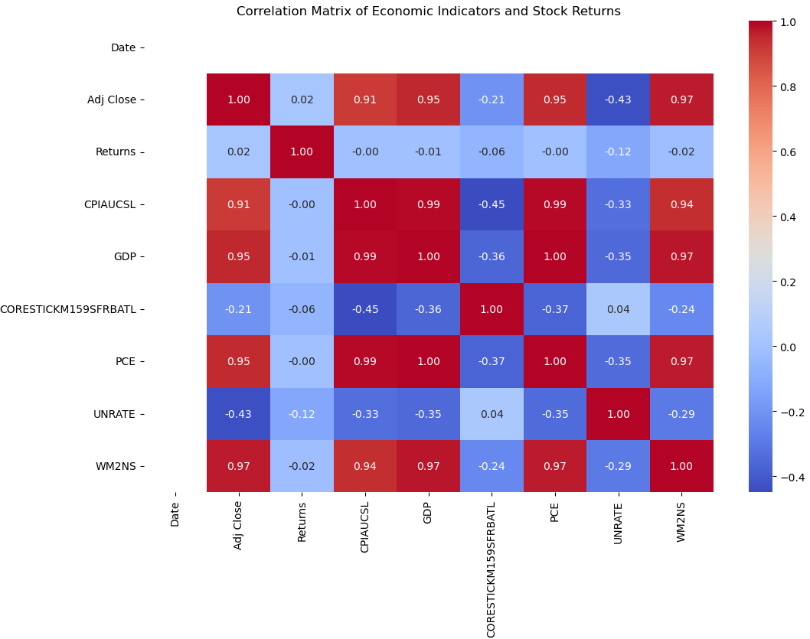
Outputs and Visualization
Correlation Analysis of Economic Indicators and Stock Returns
Strong Correlations:
GDP and PCE are very strongly correlated with stock prices - directly impact corporate profits, influencing stock prices.
Money Supply is another important indicator with strong positive correlations - Increased money supply tends to boost stock prices and consumption.
Weak or Negative Correlations:
Unemployment Rate has weak negative correlations with stock returns - indicating a less direct impact on stock performance.
Core Inflation shows a weak negative correlation with stock returns, suggesting limited influence on short-term market movements.

Slide 12
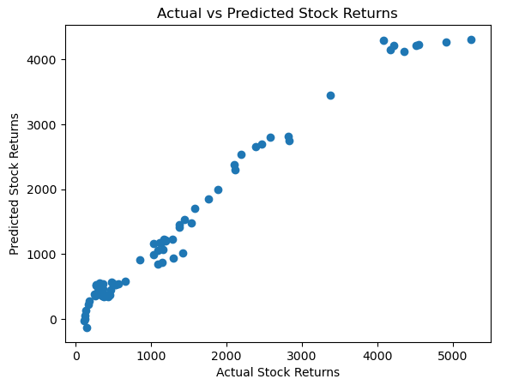
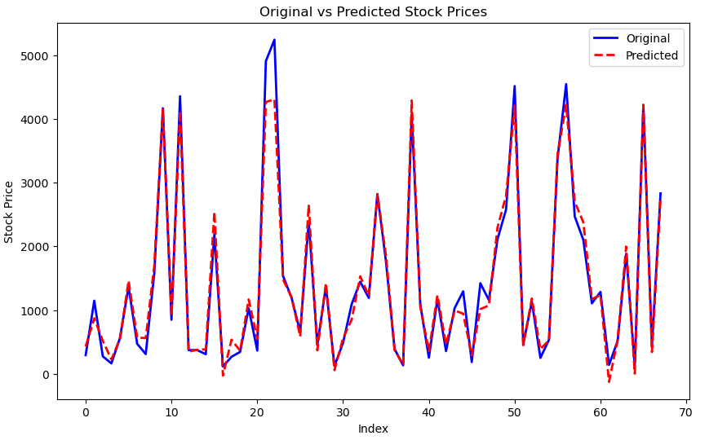
Outputs and Visualization
Model Performance Evaluation: Actual vs Predicted Stock Returns and Prices
Mean Squared Error: 43909.76583
R-squared: 0.967827645
Model Performance Metrics:
Mean Squared Error (MSE): 43,909.77 - A moderate MSE indicates that the model's predictions are somewhat accurate, but there are areas where the model's prediction can be improved. Lower values of MSE would indicate better model performance.
R-squared: 0.97 - The model explains 97% of the variance in the stock returns, suggesting excellent fit and that the economic indicators used are strong predictors of stock returns.
Actual vs Predicted Stock Returns (First Graph):
Points show a strong linear relationship between actual and predicted stock returns.
Some outliers are observed, with predicted values being higher than actual in certain instances, which is expected for stock market predictions.
Original vs Predicted Stock Prices (Second Graph):
Both the actual and predicted stock prices follow similar trends with minimal divergence, indicating the model’s good predictive capability.

Slide 13
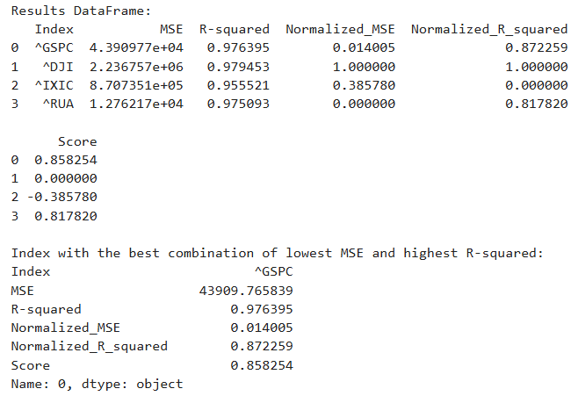
Outputs and Visualization
Analysis of Predictive Model Performance Across Market Indices
S&P 500 (GSPC):
Achieved the best overall performance with the highest score (0.858).
Balanced metrics: Low Normalized MSE (0.014) and High R-squared (0.976).
Indicates strong alignment between the model and S&P 500 behavior.
Dow Jones (DJI):
Highest R-squared (0.979), showing strong predictive power.
High MSE (2.24M) led to the lowest overall score (0.000).
Suggests potential for improvement in error reduction.
NASDAQ (IXIC):
Lowest R-squared (0.956), indicating weaker explanatory power.
Moderate performance with Normalized MSE (0.386).
Highlighted need for model refinement for tech-heavy indices.
Russell 3000 (RUA):
Lowest Normalized MSE (0.000), but slightly lower R-squared (0.975).
Ranked second overall with a strong score (0.818).

Slide 14
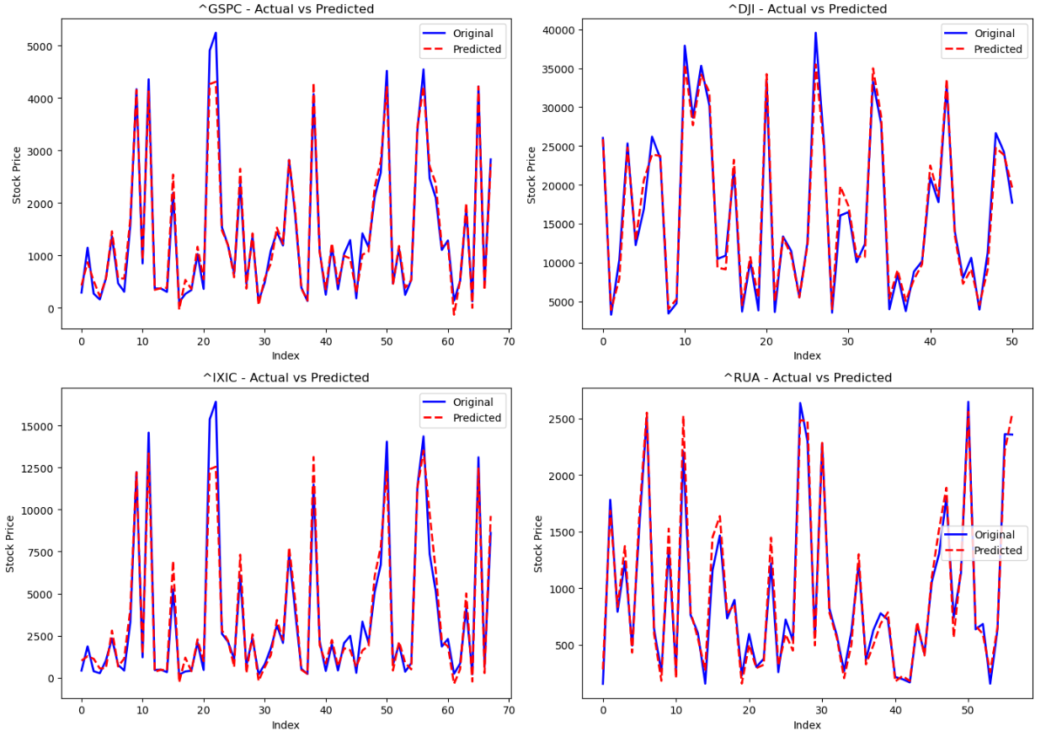
Comparison of Model Suitability
Outputs and Visualization
Aspect | S&P 500 (^GSPC) | Dow Jones (^DJI)
Metrics | - Low Normalized MSE (0.014) | - High Normalized MSE (1.000)
 | - High R-squared (0.976) | - Highest R-squared (0.979)
Representation | - Includes 500 companies, highly diversified | - Includes only 30 large-cap companies
 | - Captures a comprehensive market snapshot | - Limited market snapshot, focused on large caps
 | - Lower sensitivity to outliers | - Higher sensitivity to outliers
Economic Indicator Alignment | - Strong correlation with macroeconomic variables | - Slightly better correlation with GDP and CPI
 | - Balanced representation across multiple sectors | - Sector representation may skew macro alignment
The S&P 500 is better suited for the model due to its diversified composition, reduced sensitivity to outliers, and strong balance between metrics.
While the Dow Jones excels in R-squared, its higher MSE and limited representation make it less reliable overall.

Slide 15
CYMBAL
PRODUCT OVERVIEW
MODEL ANALYSIS AND CONCLUSION

Slide 16
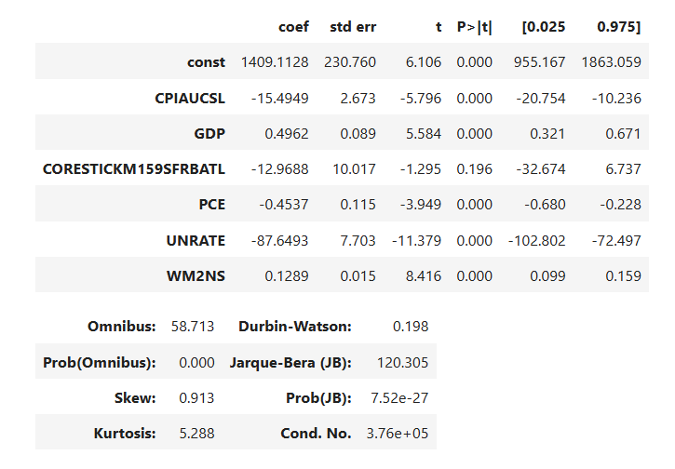
Understanding the Magnitude effect
S&P 500
As per the results obtained, overall considering the significance of 5%, the Inflation rate is not significantly affecting the outcome of the market.
The Unemployment Rate and the CPI numbers however tend to have a strong negative relationship with the overall stock market performance outcome.

Slide 17
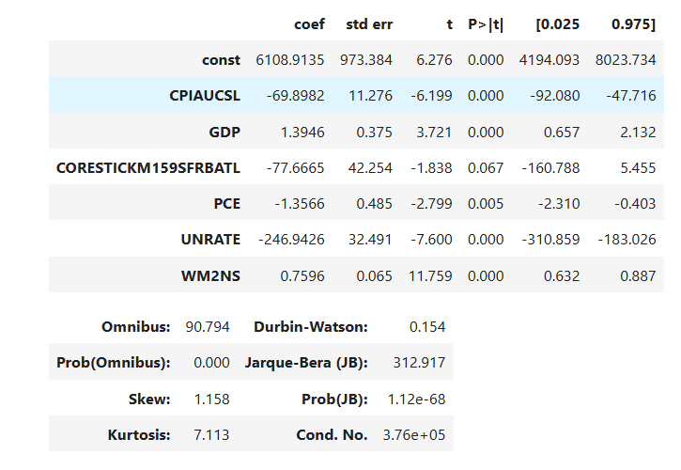
Understanding the Magnitude effect
NASDAQ Composite
As per the results obtained, overall considering the significance of 5%, the Inflation rate is not significantly affecting the outcome of the market.
The Unemployment Rate and the CPI numbers however tend to have a strong negative relationship with the overall stock market performance outcome, even more against S&P 500 thus showing sector concentration.

Slide 18
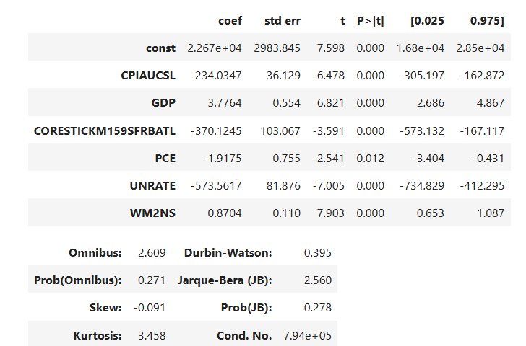
Understanding the Magnitude effect
Dow Jones Index
As per the results obtained, overall considering the significance of 5%, every economic factor is significantly affecting the index since it being the industrial average.
In this case, almost every factor is affecting the index heavily thus making it having a strong relationship with every factor.

Slide 19
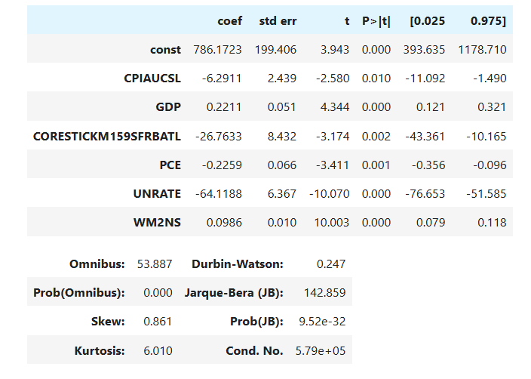
Understanding the Magnitude effect
Russell 3000
The Russell 3000 shows the power of a diversified index , not getting affected much in magnitude to the other indexes to the economic factors.
In this case, The Unemployment factor seems to have a greater impact on the index performance than the other indicators.

Slide 20
Conclusion
As far as the analysis is concerned, Dow Jones seems to have the strongest relationship with the economic indicators since it is an industrial average index
In most of the models developed, Unemployment and CPI numbers seem to have the largest impact on the stock performance
Money Supply in the economic intends to have the least impact
For a risk averse individual, buying a Russell 3000 ETF would be advisable given the less exposure to the magnitude of change
For a risk loving individual, Dow Jones would give out the best returns since it is heavily dependent on uncertain economic activity

Slide 21
Contribution
Equal Contribution towards developing the problem and charting the path for applying the model.
Interpretation of results with the analysis was done in a collaborative manner.

